Slide 1
SPSA
How to Add or Delete a Designee

Slide 2
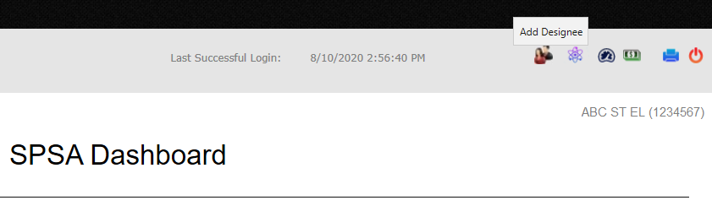
The Principal and/or Assistant Principal are the only people who can add or delete a Designee. After logging into the SPSA, to add a new designee or to remove an existing designee, click on the two-person icon located at the top right side of every page.

Slide 3
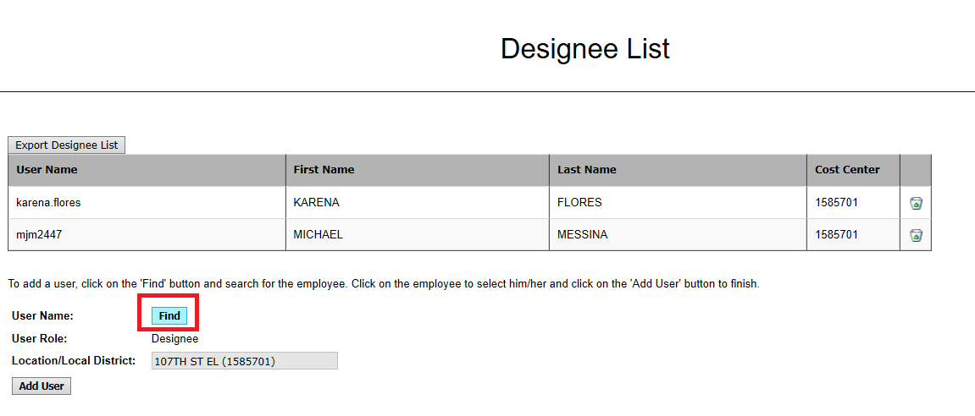
To add a new Designee, click the Find button as shown.

Slide 4
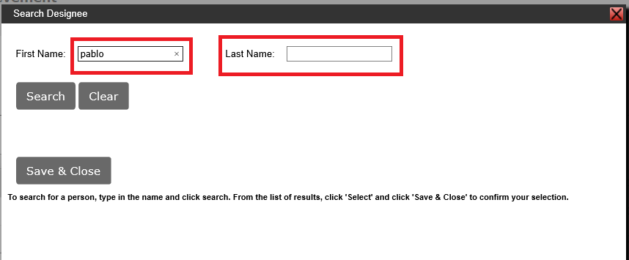
Enter the person’s first name in the First Name text box, or their last name in the Last Name text box. You can enter both their first and last name also, to narrow the search.

Slide 5
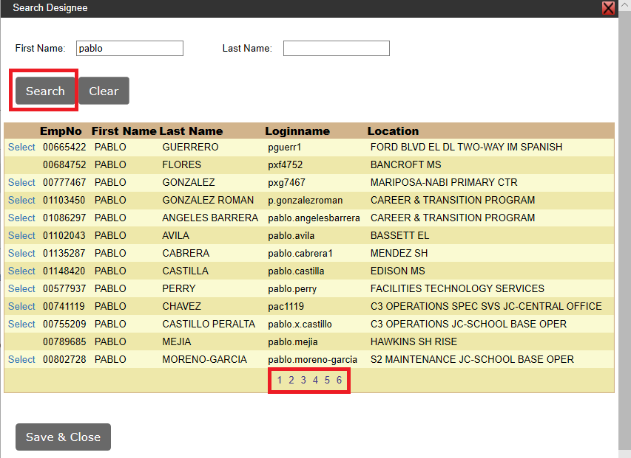
Click Search to see all the matches. Additional pages are located at the bottom of the search results.

Slide 6
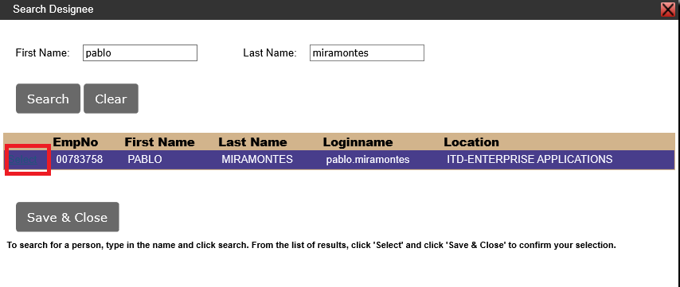
When the person searched for has been located, click the word “Select” as shown and the row will turn purple.

Slide 7
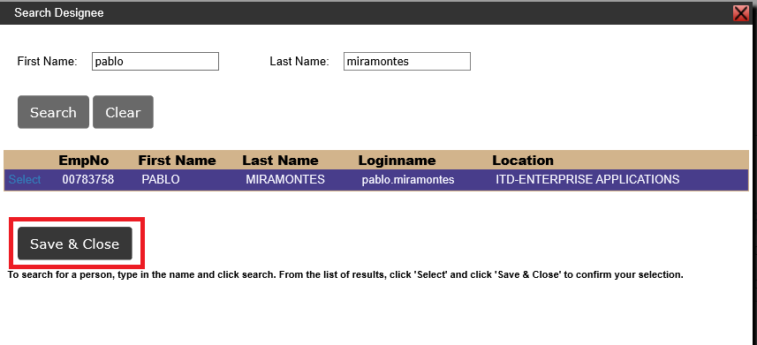
Click the Save & Close button as shown.

Slide 8
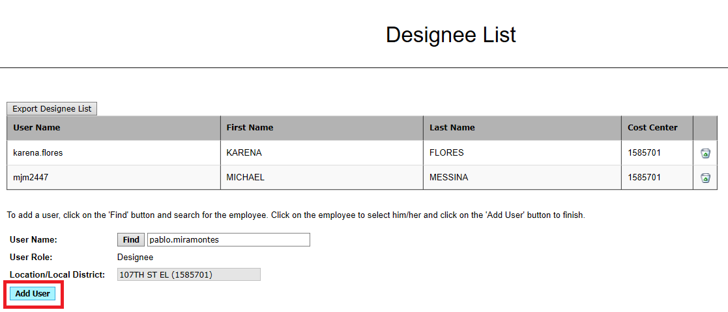
Next, click the Add User button as shown.

Slide 9
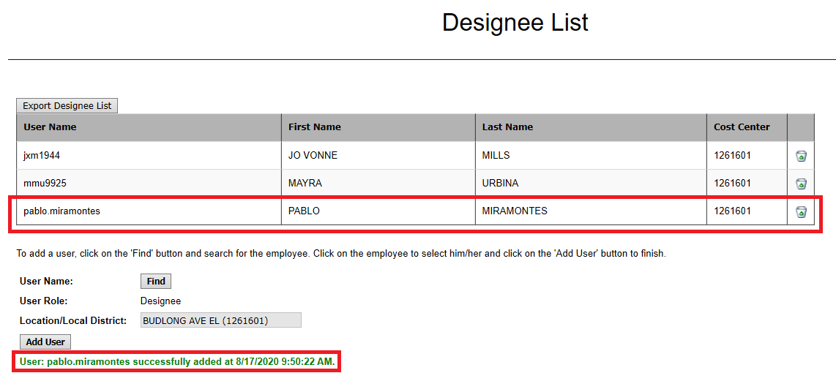
The new Designee appears.

Slide 10
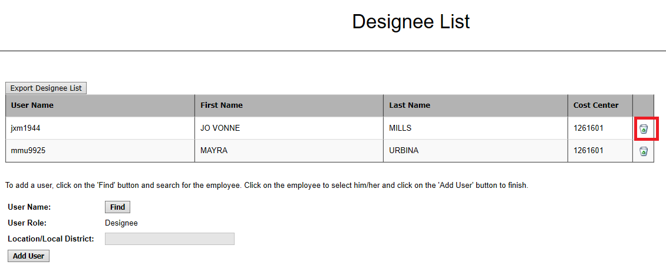
To delete a Designee, click the trash can to the right of the person’s name, as shown. The system will prompt you to verify you want to delete before deleting the Designee.

